Slide 1

SAP CUSTOMER DAY · SESSION
THIRD WAVE × HARNEY & SONS
Turning shop-floor activity
into trusted SAP data
Third Wave Business Systems
BUILT ON
SAP Business One practice
Harney & Sons Fine Teas
Fine tea manufacturing · Millerton, New York
THIRD WAVE BUSINESS SYSTEMS
TWBS.COM
Notes:
Kellen
Good morning. I'm Kellen with Third Wave Business Systems.
We’ve been implementing and supporting B1 for manufacturers and distributors for about thirty years. We have a strong history as a B1 ISV partner as well – we’ve won a few SAP Pinnacle Awards back in the day, and we’ve got tools like Bizweaver, Advanced Productivity Pack, and CreditCard that span the entire North American ecosystem.
For the past six months, Third Wave has been working on Forge AI. It all started with the idea that SAP Business One remains the source of truth in the age of AI. Forge interacts with your ERP the same way that a person or an add-on would.
Today, we’ll talk about the story of how Forge and SAP B1 works at one customer, transforming two workflows, and what actually happened when we put them in.

Slide 2

Based in Millerton, New York
Running SAP Business One
Working with Third Wave since 2016
THIRD WAVE BUSINESS SYSTEMS
Notes:
Kellen
The customer is Harney & Sons Fine Teas, and I’ve got Chris McKenna here who was so kind to make the journey over to join us. Some of you have their tea in your kitchen — they've been blending tea in upstate New York since 1983. And like a lot of the manufacturers in this room, they run SAP Business One, but also have a meaningful part of their process run on paper.
Chris — would you mind telling everyone a little more about Harney?
Chris
**Quick background on Harney and his role**
Kellen --vQuestons for Chris (only if there’s time):
What did a production shift actually look like before any of this? Walk them through a form.
Chris, when something went wrong on a paper form — how did you find out about it?
How much of a shift supervisor's day was going into paperwork rather than production?

Slide 3
Nothing reaches SAP unreviewed
THIRD WAVE BUSINESS SYSTEMS
Notes:
Kellen
Today, we’re going to look at two workflows Chris used Forge AI to setup at Harney.
As we’re going through, here’s the one nonnegotiable Chris and the Harney team needed to be true: even in the age of AI, nothing leaves SAP unreviewed. Harney went on SAP Business One for the trust in their data system, and we couldn’t jeopardize any part of that even as we were improving operations.

Slide 4
Nothing reaches SAP unreviewed
01
Human needs to input new data
02
Check the data in SAP
03
Verify the data
04
Write to SAP
THIRD WAVE BUSINESS SYSTEMS
Notes:
Kellen
Both workflows we’re going to cover today have the same shape: a messy human input, checked against live SAP data, verified by a sueprvisor, and only then written into SAP.

Slide 5
Nothing reaches SAP unreviewed
01
Human needs to input new data
02
Check the data in SAP
03
Verify the data
04
Write to SAP
THIRD WAVE BUSINESS SYSTEMS
Notes:
Kellen
In every step, Forge brings AI that sits in the middle doing the data reading and the matching, the parts that humans are innately bad at. For Third Wave, that's the design principle. If you take one thing away from this session, take the shape — this is the philosophy behind how Third Wave is bringing AI to SAP Business One.

Slide 6
Workflow 1
The Production Floor
THIRD WAVE BUSINESS SYSTEMS
Notes:
Kellen
The first workflow we’ll look at is the production floor.

Slide 7
WORKFLOW 1 · THE PRODUCTION FLOOR
THE SITUATION
Four things were true
of the floor
01
02
20+ Departments
(Food-grade) Item Traceability
Every department has its own components, batches, and quantity limits.
Every gram traces to a batch, a bin, and a production order — with a best-before date on every batch.
03
04
Rules Live in Heads
Mistakes Surface Too Late
Drying times, over-quantity limits, and who may override them varied with whoever was on shift.
A duplicated receipt or a missed component issue is found afterward, once inventory and cost are wrong.
THIRD WAVE BUSINESS SYSTEMS
TWBS.COM
Notes:
Kellen
So Chris – so when Mike first came to you with Forge, I recall there being a little hesitation on using AI, but at the time there were significant challenges your production team was facing already. Mind walking us through what things looked like in more detail?
Chris
Four things were true about Harney's floor. I'd guess at least two are true about the shop floor for every business in this room.
First, production is departmentalized — at Harney, there’s more than twenty departments making our products. Each one has its own components, its own batches, and its own sense of what a reasonable quantity looks like.
Second, because Harney works with food, every gram has to trace to a batch, a bin, and a production order, with a best-before date on every batch. That’s compliance, and many of the folks in the room are going to have their version of FDA.
Third — and this is the honest one — the rules around production existed, but they lived in people's heads.
KL interrupts: Chris, could give an example of a production process that ran on people knowing?
Chris: Sure, Drying times on a blend. How far over plan is acceptable in this department versus that one. Who's allowed to wave an exception through. None of it was written anywhere a system could read.
And fourth, the expensive one. When something did go wrong — a receipt entered twice, a component issue that never got recorded —the issue wasn’t necessarily found on the floor. It might be found downstream in inventory, or worse, in cost. And now, instead of fixing a typo in the system, we’re involving a team to go back and investigate.

Slide 8
WORKFLOW 1 · THE PRODUCTION FLOOR
HOW IT WORKS TODAY
What Chris Built | One floor event posted the same way every time
01
02
03
04
05
Operator Submits
Checked Against SAP
Supervisor Reviews
Receipt or Issue Built
Posted to SAP
FORGE
SAP BUSINESS ONE
FORGE
FORGE
SAP BUSINESS ONE
A THIRD WAVE × STRUCTIFY.AI PRODUCT
TWBS.COM
Notes:
Kellen
Wow, sounds like that was quite the challenge – and I’m sure many folks in the room can empathize with facing a similar issue at their business. What was your solution?
Chris
This is one floor event, start to finish. An operator finishes a step and needs to tell SAP about it.
Step one, the operator submits — on a shared kiosk at the line, or on their own phone.
Step two, and this is the first thing that matters: everything from here on happens server-side. The operator's device never talks to SAP directly and never holds SAP credentials. The submission is checked against the plan, the batch, the bin, and that department's quantity rules — against live SAP data, not a cached copy that might be a day stale.
Step three is the one I'd ask you to remember. Anything outside that department's tolerance stops. It doesn't post and get flagged for cleanup later — it stops, and it waits for a supervisor.
Steps four and five: the receipt or the component issue gets built with its batch allocation and dates, and posted. And every submission carries its own identifier, so a double tap or a page reload cannot create a second SAP document. That one's worth a sentence, because it's the cheapest problem to prevent and one of the most expensive to unwind.
The question I always get here is: what if the posting fails halfway through? The honest answer is that the event gets flagged for reconciliation and surfaced to a human. It is not silently retried and it does not quietly disappear. Somebody has to look at it.

Slide 9
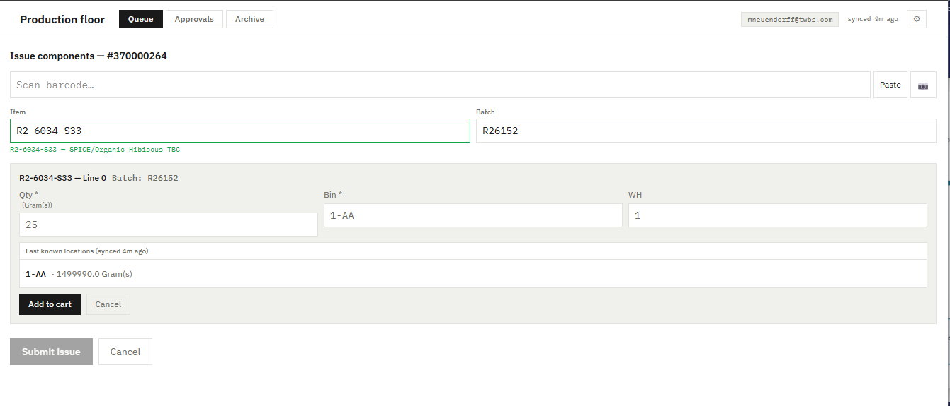
WORKFLOW 1 · THE PRODUCTION FLOOR
Forge Interfaces | Scanned at the line
Item, batch and bin come straight off the barcode
THIRD WAVE BUSINESS SYSTEMS
TWBS.COM
Notes:
Kellen
Awesome, that’s a great walkthrough of the situation. Now let’s look at what you were able to do with Forge more tactically. So to give a little bit of background, most of what you’re doing with Forge is using AI to build workflows to automate processes – think reading emails, writing sales orders to SAP, making recommendations on products to the sales team, etc.
One new feature that’s become available is Interfaces – where you can built out a web application with a front-facing UI that let’s team members or customers input information.
So now we’re showing one of the interfaces
Chris could you walk us through what we’re looking at?
Chris
Our problem is a component issue. This is a component issue, being recorded at the line. Item, batch and bin all came off the barcode — nobody typed a code.
That's step one and step two of what you just saw, on a device on the floor. The interesting part is what the operator doesn't have to know: which bin is valid, whether that batch is still in date, how much is reasonable for this department. The system already knows.

Slide 10
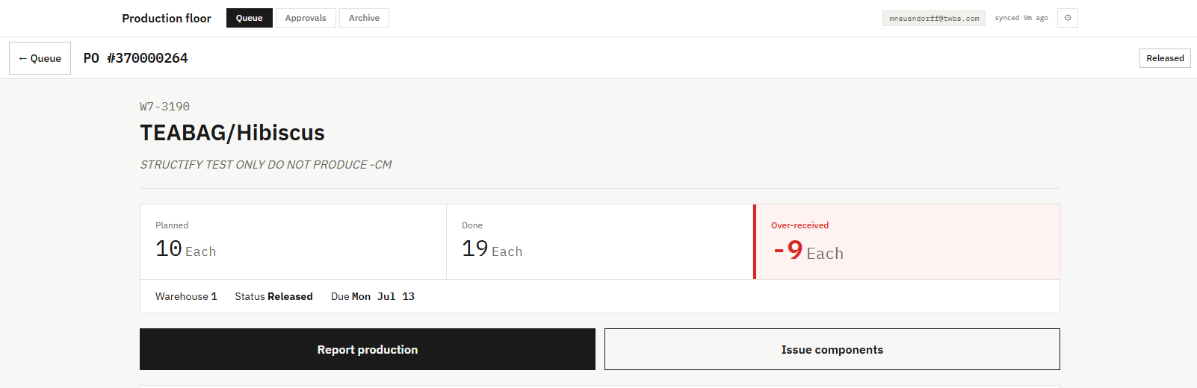
WORKFLOW 1 · THE PRODUCTION FLOOR
SEEN ON THE FLOOR
Forge Interfaces | Live Data Queue for Harney
Held for supervisor review before it ever reaches SAP.
THIRD WAVE BUSINESS SYSTEMS
TWBS.COM
Notes:
Kellen:
So this is the second part of the interface, which is a live data queue for the supervisors, correct? And what we have here is showing how a discrepancy, or 9 of them to be precise, are shown to the production supervisor.
What can you tell us about how this one was used, Chris?
Chris
This is effectively a live tracker that I built with Forge.
Like we previewed earlier, under the old process any discrepancy becomes an inventory discrepancy somebody finds next week — and by then you're reconstructing what happened from memory.
Because we’ve built a way to show the discrepancies live on the floor, a supervisor can catch it. The error never reaches SAP at all. It sits in a queue until a supervisor looks at it and decides.
And one more thing that’s cool: the tolerance for word matching is configurable – I set the first one, and eventually each department could set its own.

Slide 11
WORKFLOW 1 · THE PRODUCTION FLOOR
BUSINESS VALUE
Results | What Harney gets
01
02
Errors captured at the Line
Data scanned, not typed
Receipts and component issues are recorded where the work happens, on a shared kiosk or the operator's own phone.
Item, batch, and bin come straight off the barcode, including camera scanning on the floor's own devices.
03
04
The Same Rules Every Shift
Expandable to Other Departments
Quantity limits, drying times, and override rights are applied by the system, not recalled from memory.
New departments, rules, or line types extend the same workflow instead of forcing a re-implementation.
THIRD WAVE BUSINESS SYSTEMS
TWBS.COM
Notes:
Kellen
Really cool, Chris – you know, even after hearing about what you’ve been able to do so many times, seeing the interfaces you built live is still so awesome.
So I’m going to do my best to summarize for everyone the effect of what the process did – feel free to jump in and add in any color.
The thing to keep in mind is that there was a lot more work done with Forge workflows behind the scenes. There’s this 100-step beautifully architected workflow that Chris did that we just don’t have the time to go through today.
Here’s what’s changed for the Harney team.
First, Errors are captured where the work happens, on a kiosk or a phone, we’re recording the data as the work happens, not later on.
Second, Item, batch and bin come off the barcode instead of a pen. Which is just way more accurate – you’re not beholden to human error
Third, The rules apply the same way on every shift, regardless of who's on. So you can create a standard across a team
And lastly, when a new department or a new line type comes along, it extends the same workflow instead of triggering another project. So you think about the scalability of what we looked at here. Every department is going to have slight differences in what a standard process looks like, and the supervisors might have different expectations too. Because Forge gives the design control back to Harney, Chris can take the solution we just looked at and help adapt it to every single department without any coding – it’s all natural language and AI does the rest with the workflow and interface changes.

Slide 12
WORKFLOW 1 · THE PRODUCTION FLOOR
BUILT-IN SAFEGUARDS
Safeguards | What the system won’t let through
01
02
03
Exceptions Stop and Wait
No Duplicate Documents
Every Event Logged
A quantity beyond the department's tolerance stops and waits for a supervisor. Nothing out of range posts silently.
Submission have unique identifiers, so reload cannot create a second SAP document.
Each event records who submitted it, when, and which SAP document it became — including the attempts that failed.
THIRD WAVE BUSINESS SYSTEMS
TWBS.COM
Notes:
Kellen
Chris – you were quite thoughtful in error treatment. Walk us through what you were worried about and how you mitigated it.
Chris
***Explains his thought process on potential errors***
Kellen
these are answers to the questions every AI skeptic wants to know. Luckily, Chris, data- and process-driven person that he is, already thought of these as he was setting up the Forge workflow, so they’re baked directly into the solution he’s set up already.
Like I said, this foresight / process-orientation just made you such a powerful user of the Forge AI platform.

Slide 13
SAP Business One remains
the system of record
THIRD WAVE BUSINESS SYSTEMS
Notes:
Kellen
And underneath all of it is this. SAP Business One stays the system of record.
Forge validates, posts, and logs, but It never keeps a second set of books. There is no shadow inventory living in a tool your auditors have never heard of. You’re not running an external system or database — inventory truth lives in SAP, exactly where it lived before.

Slide 14
Workflow 2
Sales Order Processing
THIRD WAVE BUSINESS SYSTEMS
Notes:
Kellen
On to the second workflow — the order desk. Same shape as the production issue, but not we’re looking at Harney’s front of house vs. back of house.

Slide 15
WORKFLOW 2 · SALES ORDER PROCESSING
THE CHALLENGE
The Challenge | Customer Order Problem
01
02
03
Email Orders Arrive Unstructured
Order Forms Built by Hand
Errors Surface Too Late
Customer POs come in as PDFs and email text, then get retyped into SAP one line at a time.
Reps look up the customer in SAP, hunt down item and customer catalog numbers, and assemble a spreadsheet.
A miscopied item or pack size is caught downstream, and no one can see who sent what, or when.
THIRD WAVE BUSINESS SYSTEMS
TWBS.COM
Notes:
Kellen
Chris, can you walk us through what this problem looked like for Harney?
Chris
It was really two problems that required one unified solution. Going in: customer POs arrive as PDFs and email text, in whatever format the customer feels like, and somebody retypes them into SAP a line at a time.
Going out: reps hand-build order forms so customers order the right items in the first place — looking up the customer, hunting down item numbers and the customer's own catalog numbers, assembling a spreadsheet.
And tying them together, the same failure as the shop floor. A miscopied item or the wrong pack size gets caught downstream, and nobody can reconstruct who sent what, or when.
If you're wondering how a production project ended up on the order desk — that's the answer. It's the same problem. Somebody retyping something a system could have read.

Slide 16
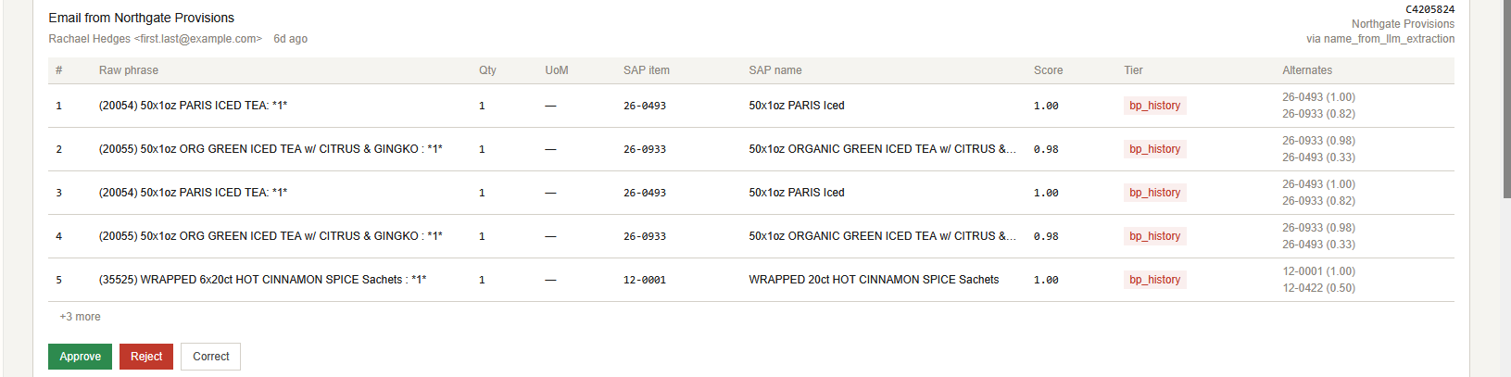
WORKFLOW 2 · SALES ORDER PROCESSING
Processing orders as the customer sent them
Forge uses AI to match text against the SAP catalog, scored against what this customer has bought before
THIRD WAVE BUSINESS SYSTEMS
TWBS.COM
Notes:
Kellen
Awesome – so this time, let’s walk through the Forge excerpts first before going through the whole solution. So this is showing how data-matching worked in Forge between an email and SAP. What’s going on here, Chris?
Chris
***Briefly goes over how Forge scrapes Outlook for emails related to customer purchasing and picks the suggested answer***

Slide 17
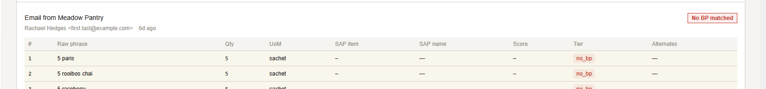
WORKFLOW 2 · SALES ORDER PROCESSING
Safeguard | When it can't match, it stops
Nothing posts until a rep approves, rejects, or corrects it.
THIRD WAVE BUSINESS SYSTEMS
TWBS.COM
Notes:
Kellen
Great, and what about this next one, what happens when Forge can’t find the answer?
Chris
This is the checkpoint. Lines the matcher is unsure about are held for a rep to approve, reject, or correct. It doesn't guess and apologize later.
Pre-empt the bad-match question here.
And when it gets one wrong, this is where it lands — with a confidence score and the alternates the system considered, and a person decides. The system is allowed to be unsure. It is not allowed to be unsure quietly.

Slide 18
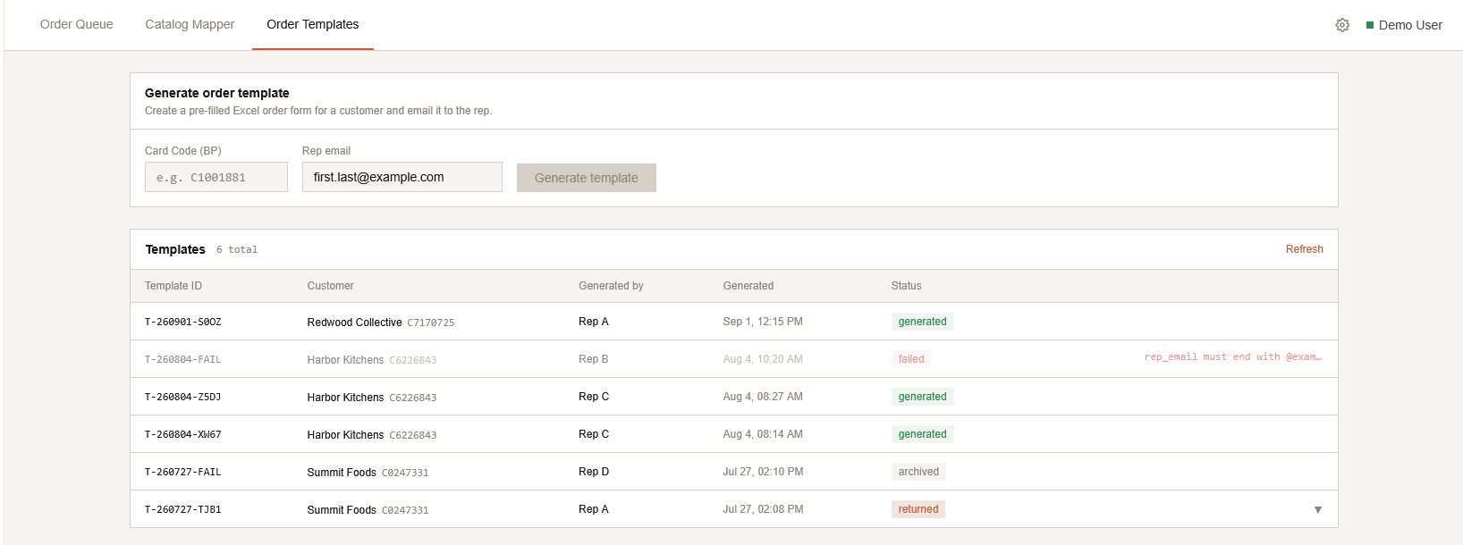
WORKFLOW 2 · SALES ORDER PROCESSING
SEEN IN THE APP
Forge Output | A pre-filled order form by BP code
With a full history of every form — including the ones that failed, and why.
THIRD WAVE BUSINESS SYSTEMS
TWBS.COM
Notes:
Chris
And the other direction. A pre-filled Excel order form, generated by Business Partner code, with the customer's own catalog numbers already in it — plus a full history of every form that's gone out.
That last part matters more than it sounds. It means when a customer says “this isn't what we ordered,” somebody can actually answer.

Slide 19
WORKFLOW 2 · SALES ORDER PROCESSING
HOW IT WORKS TODAY
How an order
reaches SAP
01
02
03
04
05
Order Arrives
Matched to SAP Data
Rep Reviews Exceptions
Order Form Built
Posted to SAP or Emailed
A rep request, or a customer PO or email.
Business partner resolved, every line matched to the catalog.
Anything the matcher is unsure about waits for a person.
A pre-filled form, or matched lines ready to post.
Either outcome is recorded against the request.
FORGE
SAP BUSINESS ONE
FORGE
FORGE
SAP BUSINESS ONE
A THIRD WAVE × STRUCTIFY.AI PRODUCT
TWBS.COM
Notes:
Chris
So putting it all together in the solution.
There’s two ways an order arrives, but we want one validated path for that information to get into SAP. It starts either with a rep asking for a pre-filled form, or with a customer PO landing in an inbox.
Step two, the system resolves the business partner and matches every line against the SAP item catalog — and it uses that customer's own purchase history to break ties. When a line says “English Breakfast, case,” the thing that disambiguates it is what that customer has actually bought before.
Point at the highlighted node.
And step three is the same step three. Anything the matcher isn't confident about stops and waits for a person. Same principle, different desk: nothing reaches SAP unreviewed.
Step four produces either a pre-filled Excel order form or matched order lines ready to post. Step five, it's emailed to the rep or posted to SAP — and either way, the outcome is recorded.
Three of these you can see. Let me show you.

Slide 20
WORKFLOW 2 · SALES ORDER PROCESSING
BUSINESS VALUE
What the order desk
gains
01
02
Faster Order Prep
Less Retyping
No manual SAP lookups or hand-built spreadsheets to answer a customer's order request.
Customer POs are extracted and matched against the SAP catalog instead of keyed in line by line.
03
04
Consistent Experience
Scales with Volume
Every rep produces the same structured, recognizable order form.
More customers and more inbound orders without a proportional increase in manual work.
THIRD WAVE BUSINESS SYSTEMS
TWBS.COM
Notes:
Four gains for the order desk. Lead with faster prep and less retyping.

Slide 21
WORKFLOW 2 · SALES ORDER PROCESSING
BUILT-IN SAFEGUARDS
Safeguards | What the system won’t let through
01
02
Reviewed Before Posting
Every Outcome Logged
Matches the system is not confident about are queued for a rep to approve, reject, or correct before they reach SAP.
Each order form records who requested it, when, and how it ended — including the ones that failed, and why.
THIRD WAVE BUSINESS SYSTEMS
TWBS.COM
Notes:
Kellen
And what about the safeguards on this one? What was going through your mind on this?
Chris
Uncertain matches are reviewed before posting. Every outcome is logged, including the failures and why they failed.
This started as a production project, but there was one thing that landed this on the order desk

Slide 22
Generating an order form
never creates a Sales Order.
It never changes Business Partner or Item Master data. Posting is a separate, reviewed step.
THIRD WAVE BUSINESS SYSTEMS
Notes:
Critical boundary. Generating a form is not creating a Sales Order.

Slide 23
HARNEY & SONS · TWO WORKFLOWS
RESULTS
What it
adds up to
20+
100k+
15
PAPER FORMS REPLACED WITH DIGITAL CAPTURE
SAP RECORDS MATCHED AND ORGANIZED
SEATS ACROSS PRODUCTION, PROCUREMENT AND COMMERCIAL
THIRD WAVE BUSINESS SYSTEMS
TWBS.COM
Notes:
Figures pending Harney sign-off. Confirm before the show or hide this board.

Slide 24
The question isn't whether AI can read your forms
It's what truth looks like between AI and your ERP
THIRD WAVE BUSINESS SYSTEMS
Notes:
Close on the question. Hand back to the room.

